Slide 1

Fixers
Augmented Reality Interior Design Application
Hackaholics 4.0

Slide 2


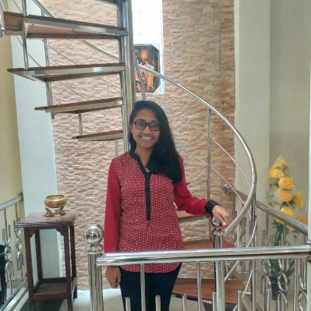
Our Team
Heshani Fernando
Vinuri Piyathilake
Asini Pathmila

Slide 3
Concept
What is Augmented Reality ?
Computer/mobile Generated Data
(Augment)
Augmented
Reality
Physical, real world
Environment
(Reality)

Slide 4
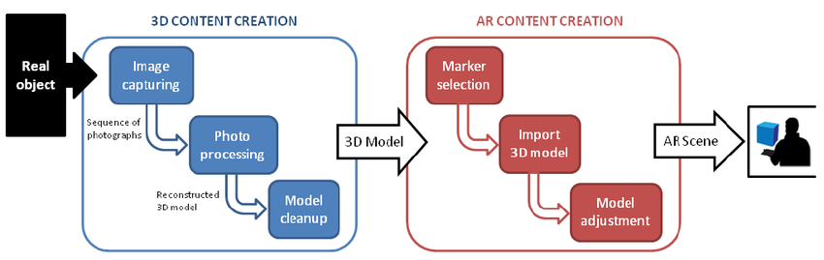
Concept
How does it work?
Pick a real world scene
Virtual object added in it
Visualizes the digital as if it’s real

Slide 5
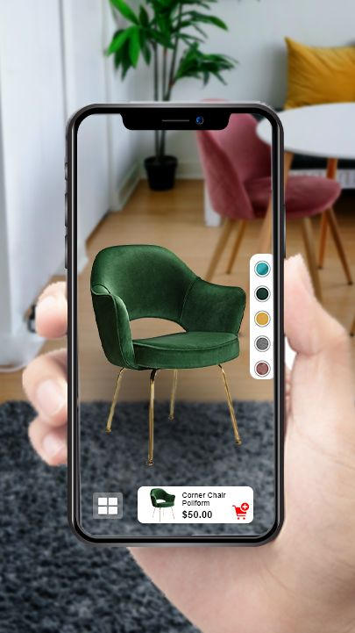
Usability
The Indoor Magic application will utilize AR Tech to help people visually envision the furniture in their home before their purchase.
Select the furniture from the Online Catalog
Resize/move/scale the items to fit for your space
Customize the furniture based on available options (e.g. color/size)

Slide 6
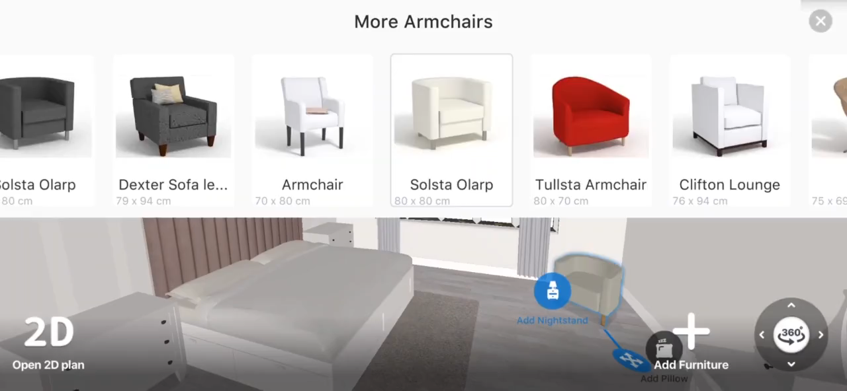

Slide 7
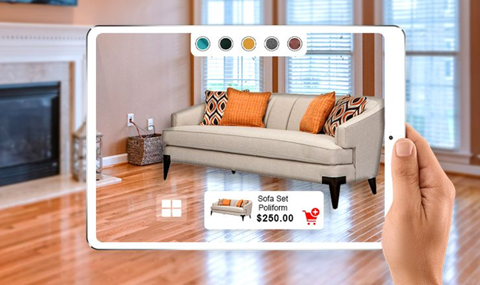
Features
Transform Your Space From 2D to 3D
View and Shop interior design products using Augmented Reality
Test thousands of interior design products at your own home
Save & Share Your Designs with others
Upgrade costs of interior solutions throughout the design process
Search new interior design ideas

Slide 8
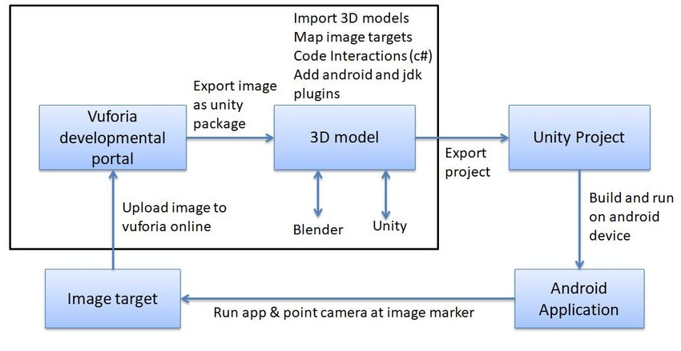
Implementation

Slide 9
Technologies
Discover the market of existing SDKs and platforms for augmented reality development. For example, platforms like Vuforia, Wikitude, Unity and ARToolKit require a profound knowledge of C ++, Java, or C#.
Create a two-dimensional tracker, which is a particular image that is positioned on a surface and scanned by AR-enabled devices.
Create a unique design and gather all of the necessary 3D models using photoshop and sketchup, photographs, text files, and data.
Use google cloud storage for cloud services

Slide 10
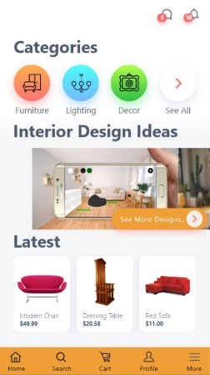
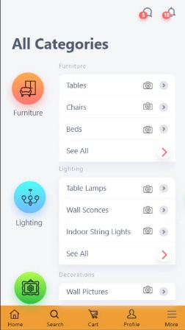
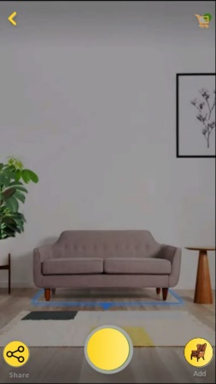
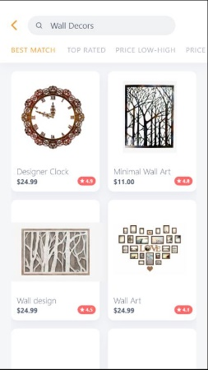
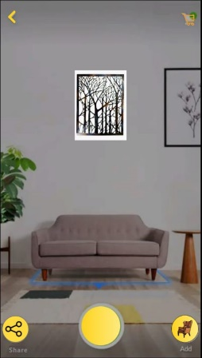
Business Value
Shop Experience
Online Retailer
Improves customers purchase rates
Provide accurate product representations
End user
Save effort
Do the right purchase

Slide 11
Business Value
Reduce return rate
Online Retailer
Reduce the rate of returns
Improve profitability
End user
Purchasing Accuracy
Save time
Save money

Slide 12
Business Value
Improve customer loyalty
Online Retailer
Improve the sales of products
long-term profits
End user
Improve customer satisfaction

Slide 13

Business Value
Social Network integration
Online Retailer
Create product awareness
Increases chances of a sale
End user
Share in real-time
Get suggestions from friends

Slide 14
Thank You!

